Slide 1
Bovée and Thill Business Communication Hall of Fame
Weebly’s Email Template for Nontechnical Users

Slide 2
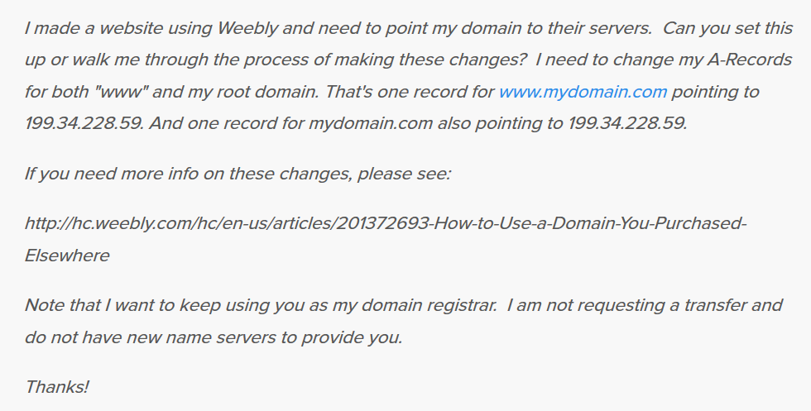
Email template saves users from learning technical details

