Slide 1
Bovée and Thill Business Communication Hall of Fame
WPP simplifies a complex communication challenge

Slide 2
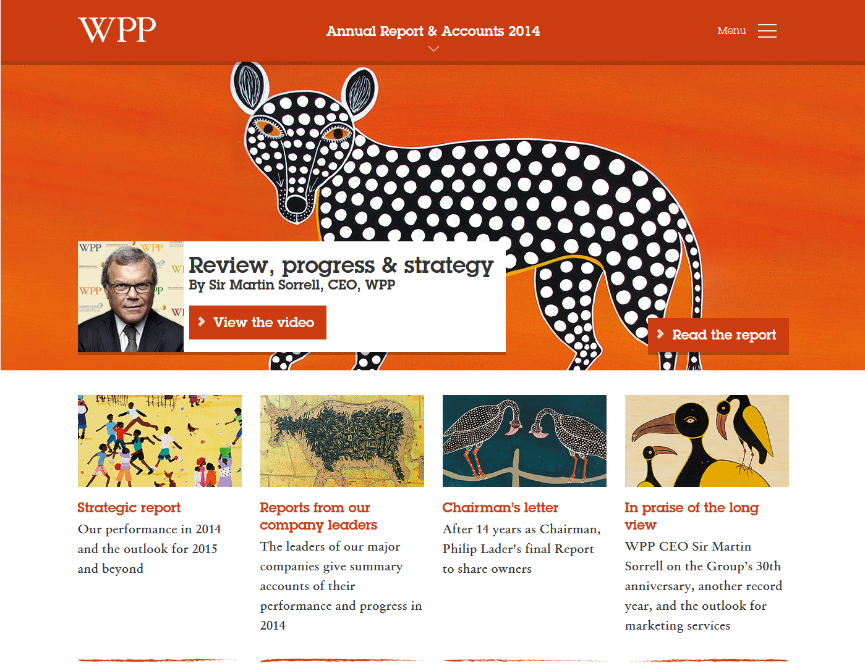
WPP: Helping readers find their way through a complex report
(screen 1 of 3 on the 2014 annual report landing page)
First screen of landing page lets readers choose from multiple paths and opt to read or watch video.
Four major sections are highlighted here as standalone reports.
Summaries help readers choose what to click.
Notes:
The London-based holding company WPP Group is the world’s largest marketing communication services firm, with more than 150 component companies involved in every conceivable aspect of advertising and related business activities. All together, WPP companies have nearly 180,000 employees in more than 100 countries. Trying to report on the annual progress of an organization this complicated is no easy task, but WPP’s intelligent, reader-friendly choices make its online annual reports easy to navigate and consume.
This report can be found at http://www.wpp.com/annualreports/2014/
(When the 2015 report is eventually published, we assume it will be found at http://www.wpp.com/annualreports/2015/)

Slide 3
Offering site visitors an alternative to reading
(the embedded video player)
Website visitors who would rather watch than read can click the link for a message from the CEO.
Section tags in the play bar overcome one of the biggest downsides of video as a communication medium.
Notes:
Just a quick detour to the video that plays when visitors click the “View the video” link on the landing page. Viewers can see and jump to section headers embedded in the video by hovering over the dots within the player timeline. This is a nice touch that helps overcome one of the major traditional drawbacks of video—being unable to find and jump to target sections quickly and easily, forcing viewers to use the hit-and-miss tactic of fast-forwarding or rewinding.

Slide 4
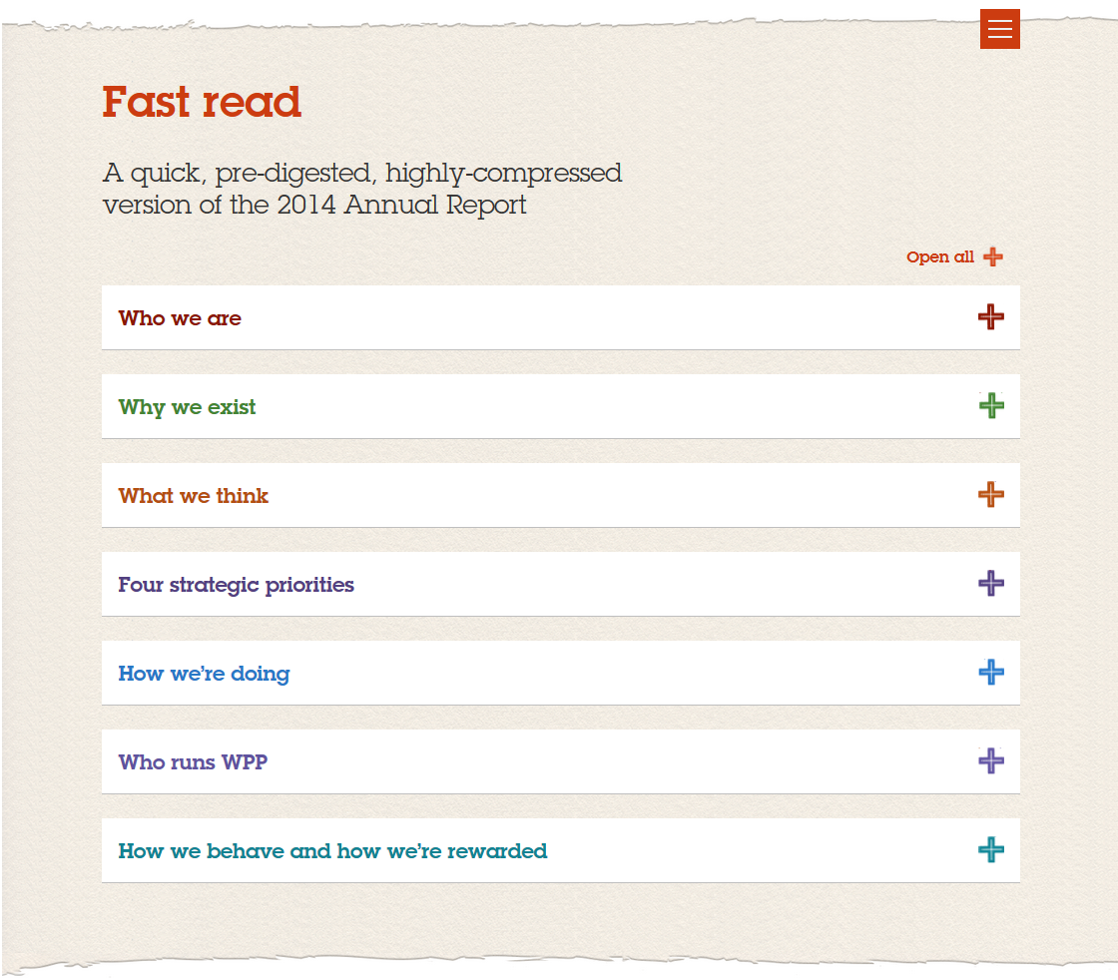
Summarizing major topics for time-pressed readers
(screen 2 of 3 on the 2014 annual report landing page)
Readers can access seven hyper-concise topic summaries that together form an effective executive summary.
Section headers are utterly clear and straight-forward, with no gimmicky word play or other potential stumbling blocks.
Notes:
By scrolling down the landing page (one “swipe’s worth” on a tablet), readers can access seven concise summaries that convey the report’s high-level messages. Together, these summaries provide an effective executive summary than can be read in just a few minutes. In each summary section, readers can click through to additional layers of detail if they’re interested.
One style note to mention: We might’ve chosen something other than “pre-digested” in the intro label here, both to avoid the unpleasant connotation of digestion and because digesting or otherwise processing information is something that the reader ultimately does, not the writer.

Slide 5
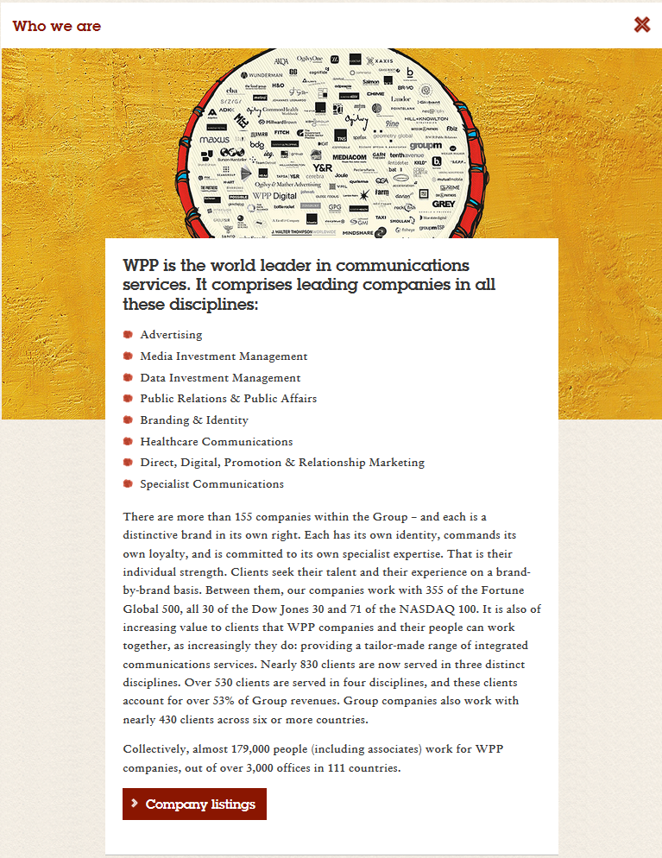
Offering concisely packaged summaries of major report sections
(showing one of the “Fast read” pop-out sections)
Here is the first of the seven pop-out sections under “Fast reads.”
This summary can be read in less than a minute, and readers who want more detail can click through to get it.
Notes:
The section summaries are admirably concise.

Slide 6
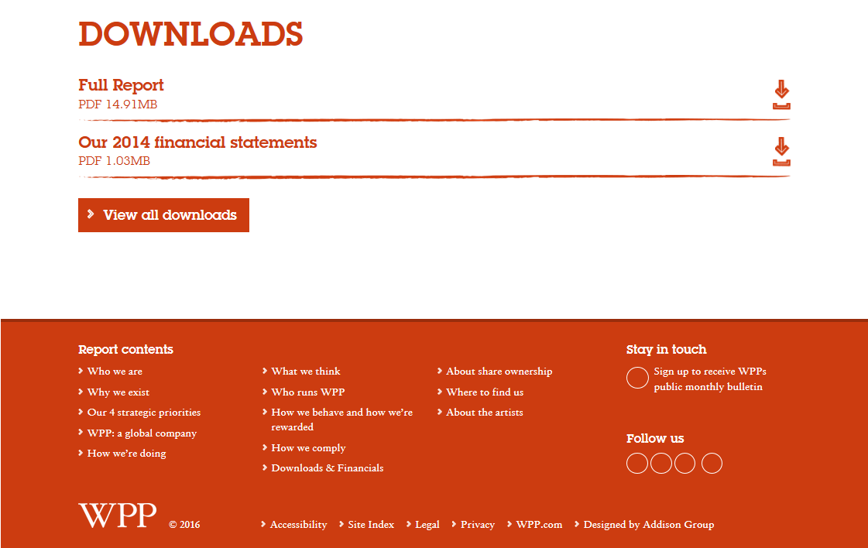
Offering the full report in printable format
(screen 3 of 3 on the 2014 annual report landing page)
Readers who want the entire report (or only the financial statements) as a single file can download both PDFs here.
Duplicate navigation links let readers jump to specific report sections without scrolling back up the landing page.
Notes:
By scrolling/swiping one more time, readers see links to a PDF of the entire report and to a subsection with just the annual financial statements. Navigation links at the bottom of the page make it easy to jump back to individual sections in the report.
One interesting technical behavior here that we would have to consider a design mistake: The circles under “Follow us” are empty because an ad blocker in the browser we used prevented the display of the social media icons for Twitter, Facebook, LinkedIn, Google+, and YouTube.

Slide 7
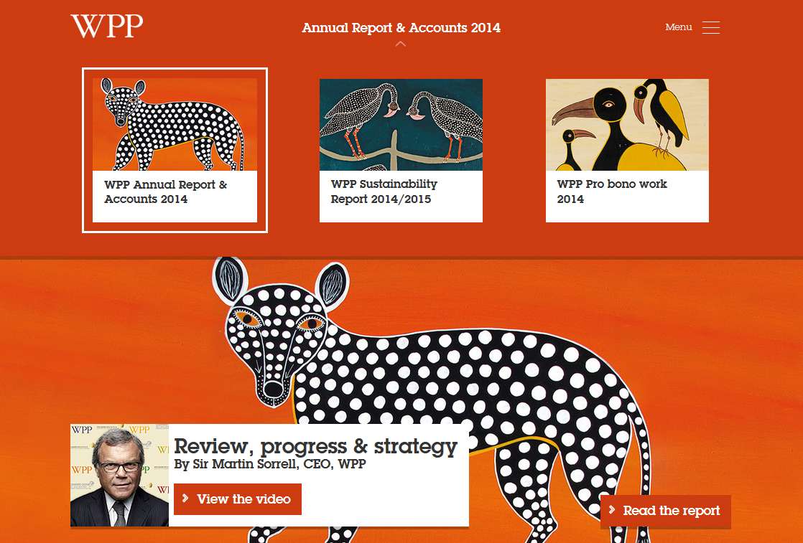
Providing easy access to other reports of potential interest
(drop-down menu at top center of landing page)
Drop-down menu at top center of the landing page provides access to two other reports that some visitors will want to see.
Note also how the entire report’s look-and-feel is unified by a common color palette and thematically related artwork.
Notes:
One final feature of the landing page: The “Annual Reports & Accounts 2014” title in the top center has a top-down menu that offers one-click access to two other annually issued reports that many site visitors will be curious about, in addition to the conventional Annual Report. One of these is on the subject of sustainability and the other highlights WPP’s pro bono work.
This screen also showcases two key design elements: the color palette that unifies the entire web package and the thematically related artwork that helps tie all the parts together while suggesting WPP’s global reach (the illustrations were commissioned from artists all over Africa). Few report writers can afford to commission custom artwork for their reports, as WPP does for its annual reports, but careful use of free and low-cost stock images (and color palettes based on that imagery) can help any business communicator accomplish the same goal.

Slide 8
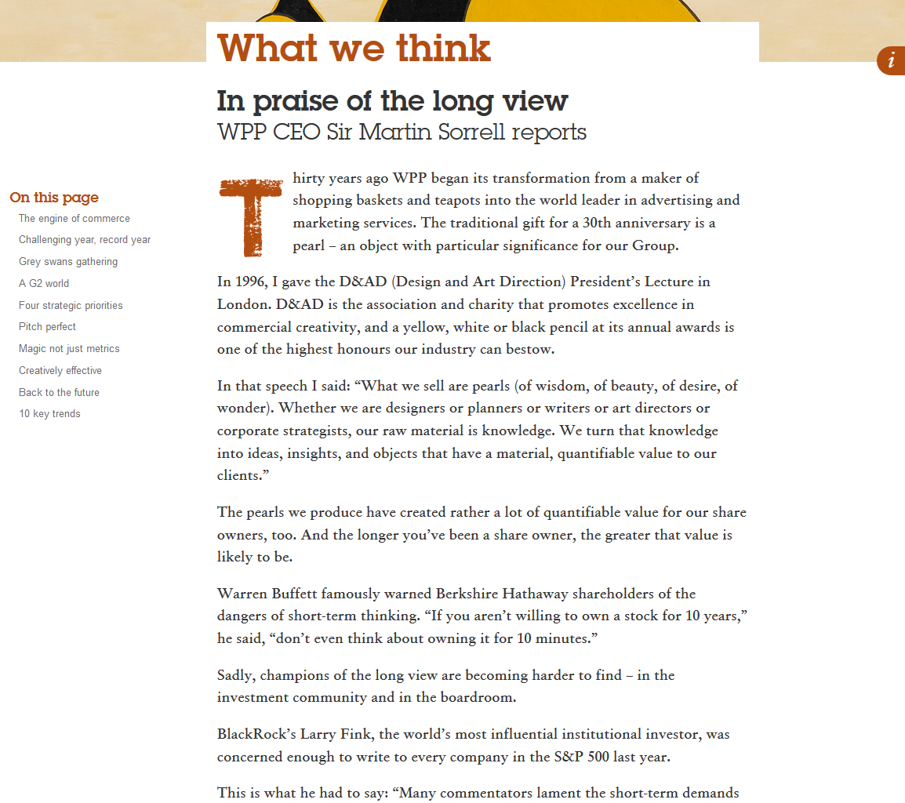
Making individual sections easy to navigate
(one of the four featured sections)
Each major section in the report has its own clickable table of contents so readers can jump to parts of interest.
The table of contents floats, so it always stays in view even as readers scroll down.
Notes:
Here is a feature that may seem minor but definitely improves readability by facilitating navigation. Each major section of the annual report has its own clickable table of contents in the left margin, so readers can easily jump forward (or backward) as their interests take them.

Slide 9
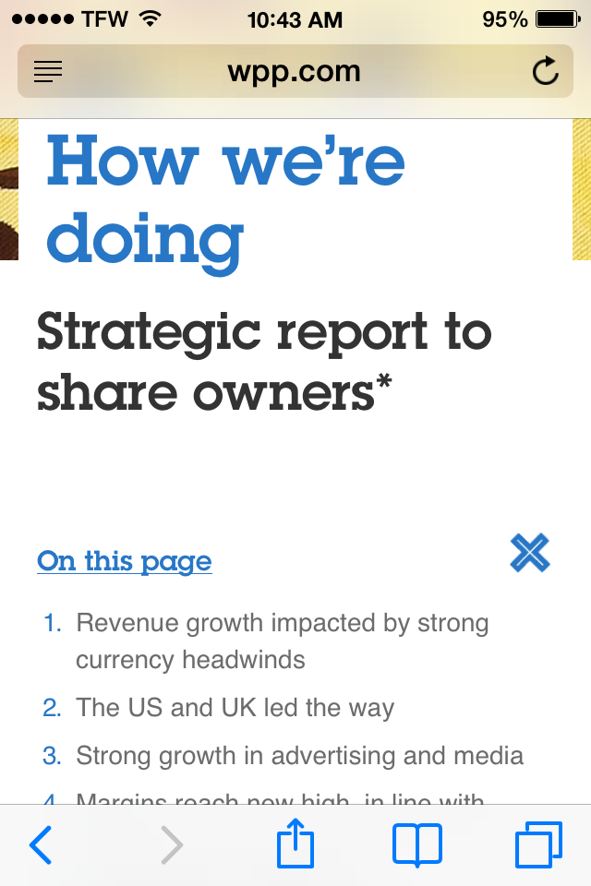
Making it mobile-friendly
(screen shot taken on mobile device)
The report is also easy to read on mobile devices.
Short headlines and simple navigation are among the keys to ensuring readability on small screens.
Notes:
Lastly, the report also renders nicely on small mobile devices. The short, straightforward headlines and clear navigation links are key aspects of mobile readability.

